Slide 1


Slide 2


Experience Builder
Second Year Project Synopsis Submitted by
ROLL | NAME
Swastik Mishra | 2401010019
Gauri Katiyar | 2401010048
Pallavi Roy | 2401010093
Yash Raj | 2401010008
Faculty Mentor: MS Mansi kajal

Slide 3

Project Overview
Medico is an intelligent healthcare platform designed to decode complex medical reports and empower users with understandable, actionable insights. By leveraging advanced AI and natural language processing, Medico interprets report content in simple terms, helping users understand diagnoses, test results, and medical terminology that would otherwise require professional guidance.
Our app not only demystifies medical jargon but also recommends effective treatment options and connects users with the most suitable doctors or specialists based on their specific condition. Medico bridges the gap between healthcare data and real patient understanding—eliminating confusion, saving time, and making quality care more accessible for everyone.

Slide 4
Problem Statement
Problems Identified:
Medical reports are hard to understand for non-medical users.
Patients face confusion and delays in treatment.
No simple tools exist to explain report findings.
Finding the right doctor is time-consuming.
Need for a Solution:
A system that decodes medical reports and explains them in easy-to-understand language.
A platform that suggests appropriate cures or treatments based on the report analysis.
A recommendation engine that connects users with the best doctors or specialists for their specific condition.
An accessible, user-friendly app that empowers individuals to take informed action on their health without needing deep medical knowledge.

Slide 5
About the Problem
Existing Solutions & Their Limitations:
Health Portals & Diagnostic Apps (e.g., HealthVault, LabCorp): Provide access to reports but do not explain medical terms or suggest treatments.
Symptom Checker Apps (e.g., WebMD, Ada): Offer general suggestions based on symptoms, not specific report-based analysis.
Online Doctor Platforms (e.g., Practo, Zocdoc): Help book doctors but don’t interpret reports or recommend treatments based on the data.

Slide 6
Problem Statement
Problem Statement – Medico
The healthcare system faces challenges such as:
Disorganized patient records and inefficient appointment management
Limited access to real-time medical data for both doctors and patients
Fragmented communication between patients, doctors, and diagnostic services
There is no unified, user-friendly solution that:
Streamlines patient-doctor interactions and appointment scheduling
Centralizes health records and diagnostic reports for quick access
Provides cost-effective, accessible digital healthcare tools for clinics and individuals
Medico aims to bridge this gap by offering an integrated, efficient, and affordable digital healthcare management platform.

Slide 7
Our Solution
Medico empowers:
Patients to understand complex medical jargon and take proactive steps in their care journey.
Caregivers to support elderly or unwell family members with clarity and confidence.
Students of biology, medicine, and healthcare to explore real-world diagnostics through AI.
Doctors by reducing repetitive explanation time and improving patient comprehension.
Rural or underserved populations who lack immediate access to healthcare professionals.
Busy professionals who want quick, digestible insights before scheduling a consultation.
Medical researchers to analyze patterns in report data for studies and insights.
Health startups to integrate intelligent report analysis into their services.
Digital health platforms looking to enhance UX with smart report interpretation.
Language-challenged patients who struggle with English or medical terminology
This is not just a health app — it's a bridge between diagnosis and understanding, built with empathy and intelligence.

Slide 8
Objectives
Main Goal :
To develop an intelligent mobile platform that interprets medical reports and guides users toward understanding and treatment.
Key Objectives:
Build a user-friendly mobile app with intuitive UI/UX for report uploading and viewing.
Integrate AI/NLP to extract and simplify complex medical terminology.
Enable real-time insights on possible causes and recommended cures.
Suggest verified doctors or specialists based on the report's findings.
Demonstrate the solution with real report examples and accurate health recommendations

Slide 9

Methodology, Tools, and Techniques
Step-by-Step Approach – Medico
Research & Analysis Identified user pain points in understanding medical reports and choosing the right doctor.
Design & Prototyping Created user-friendly wireframes using Figma with focus on accessibility.
Database Design Structured a scalable MongoDB database for storing reports, user data, and doctor info.
Development
Frontend: React.js for smooth and responsive UI
Backend: Node.js + Express for handling logic and APIs
Database: MongoDB for efficient data storage
Testing & Improvements Collected user feedback and made continuous improvements.
Deployment Live demo hosted on Netlify with backend possibly on Heroku or Render

Slide 10
Methodology, Tools, and Techniques
Frontend:
HTML, CSS, JavaScript (or possibly React.js)
Backend:
Node.js + Express
Database:
MongoDB (NoSQL, for handling varied medical data)
Design:
Figma (wireframes and UI)
Adobe XD (alternative UI concepts)
Others:
GitHub (version control)
Postman (API testing)
Netlify/Vercel (deployment platform)

Slide 11

Methodology Flowchart
1. . User accesses The Medico website.
2. Searches or browses doctors/services.
3. Views doctor profiles and details.
4. Books an appointment via a form.
5. Appointment data is saved and confirmed.
6. Admin manages doctors and bookings via backend.
7. Website is responsive and deployed on Netlify.

Slide 12
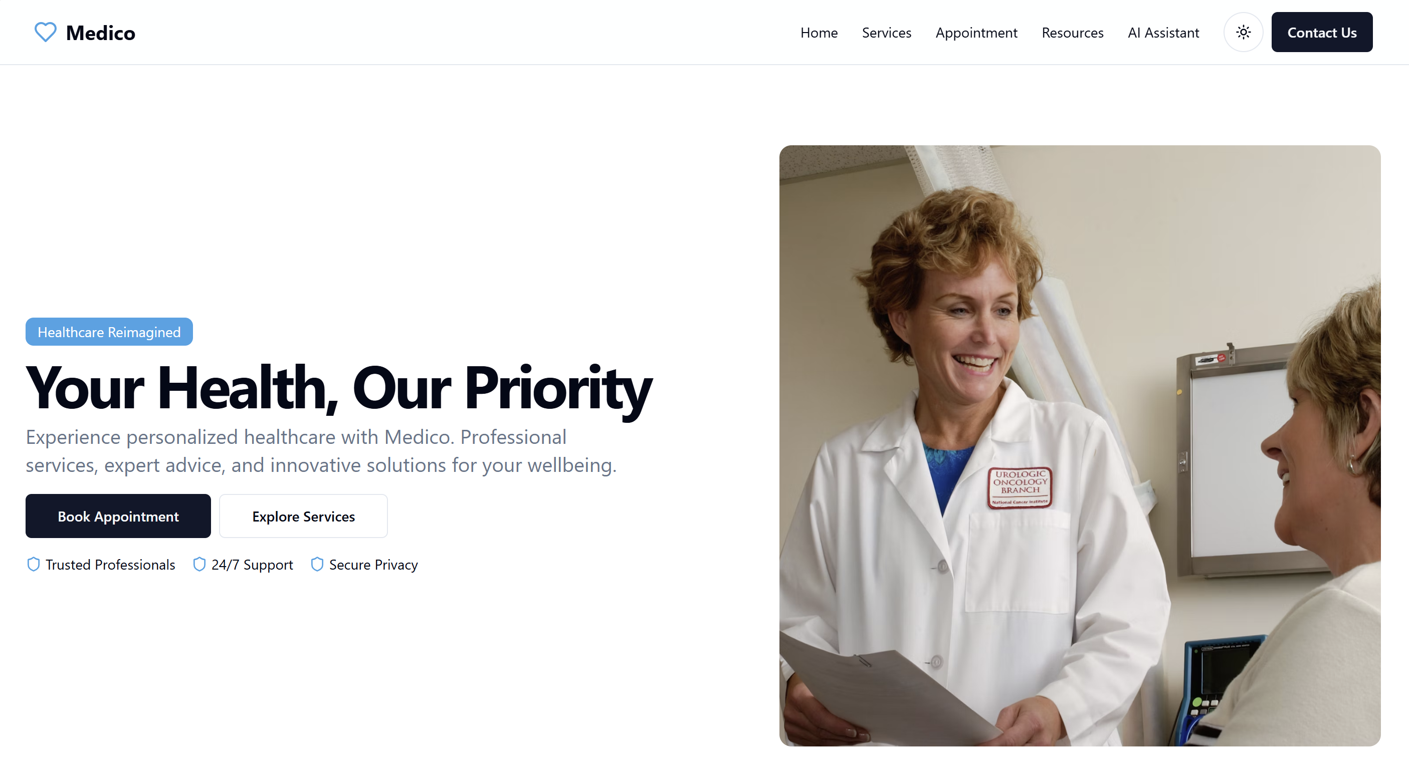

Slide 13
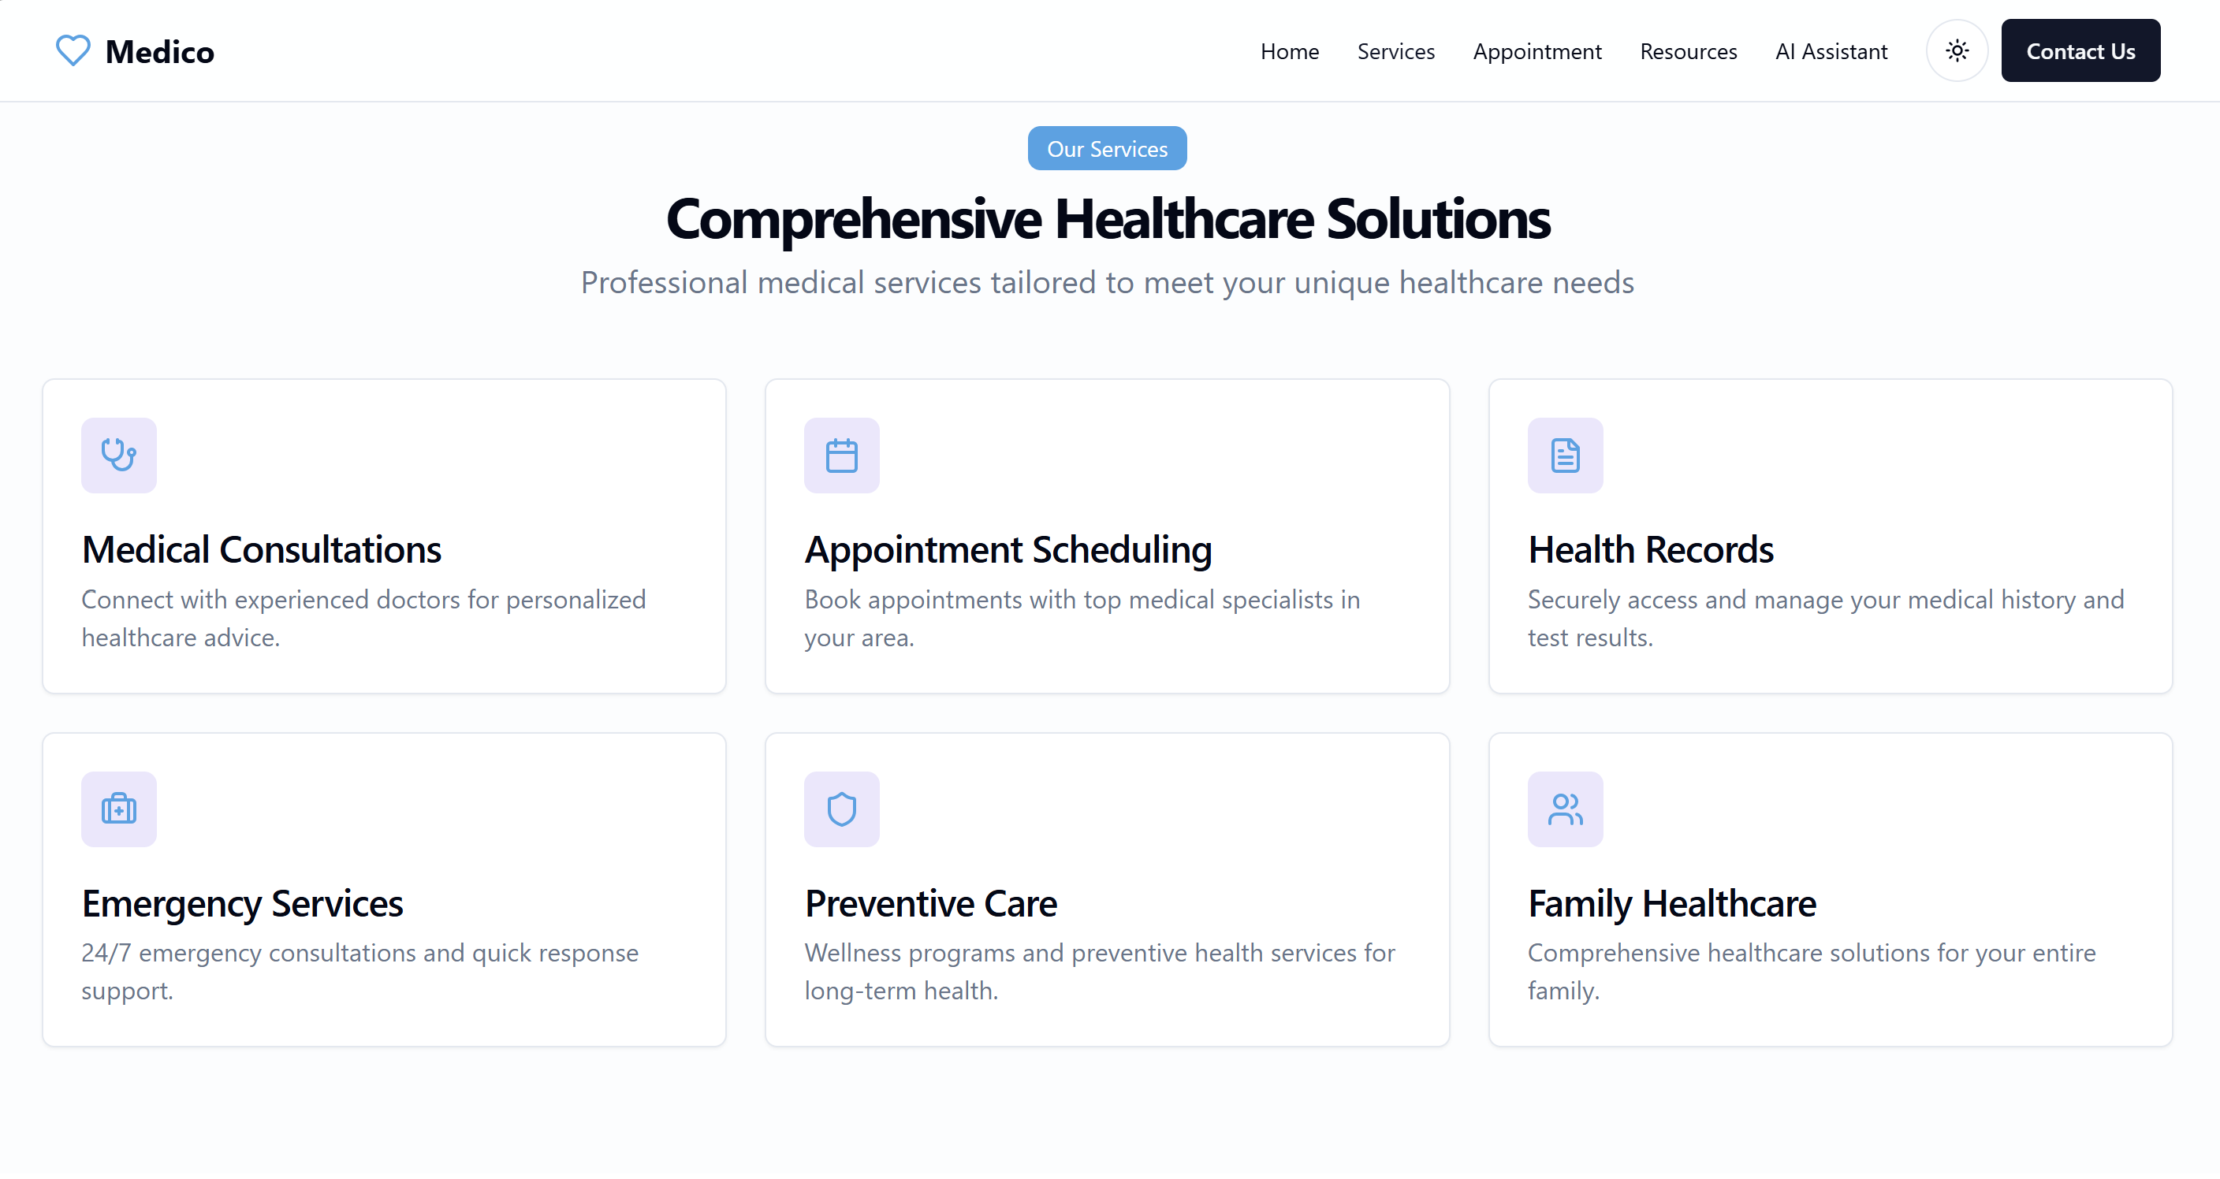

Slide 14
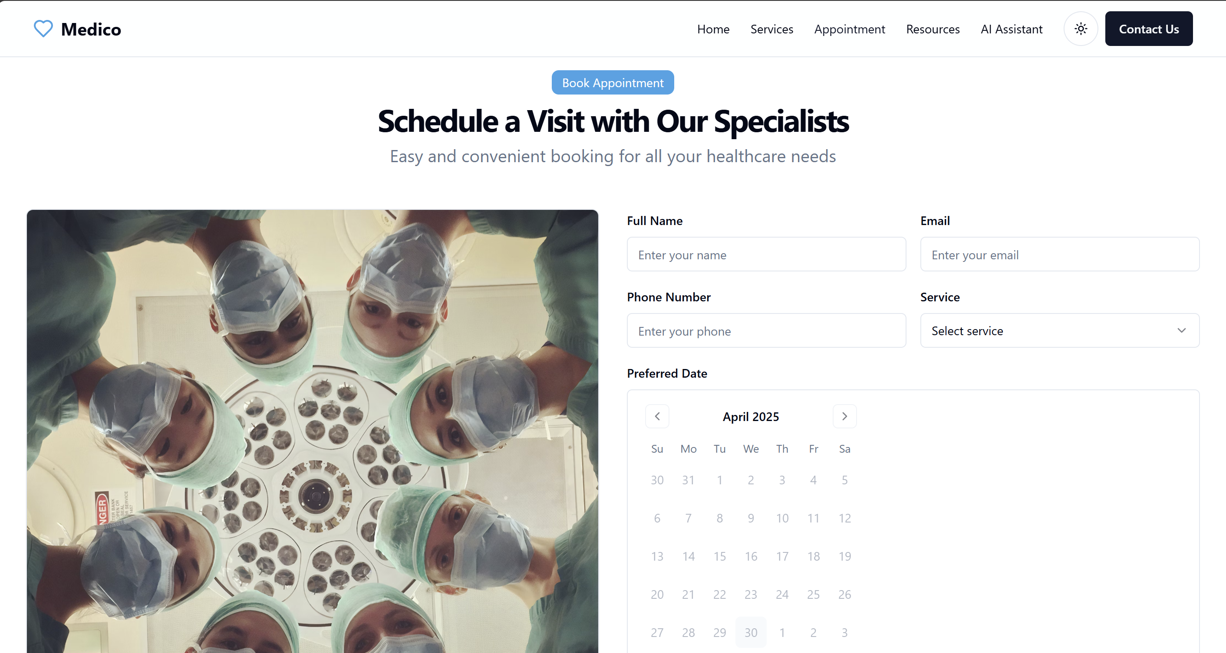

Slide 15
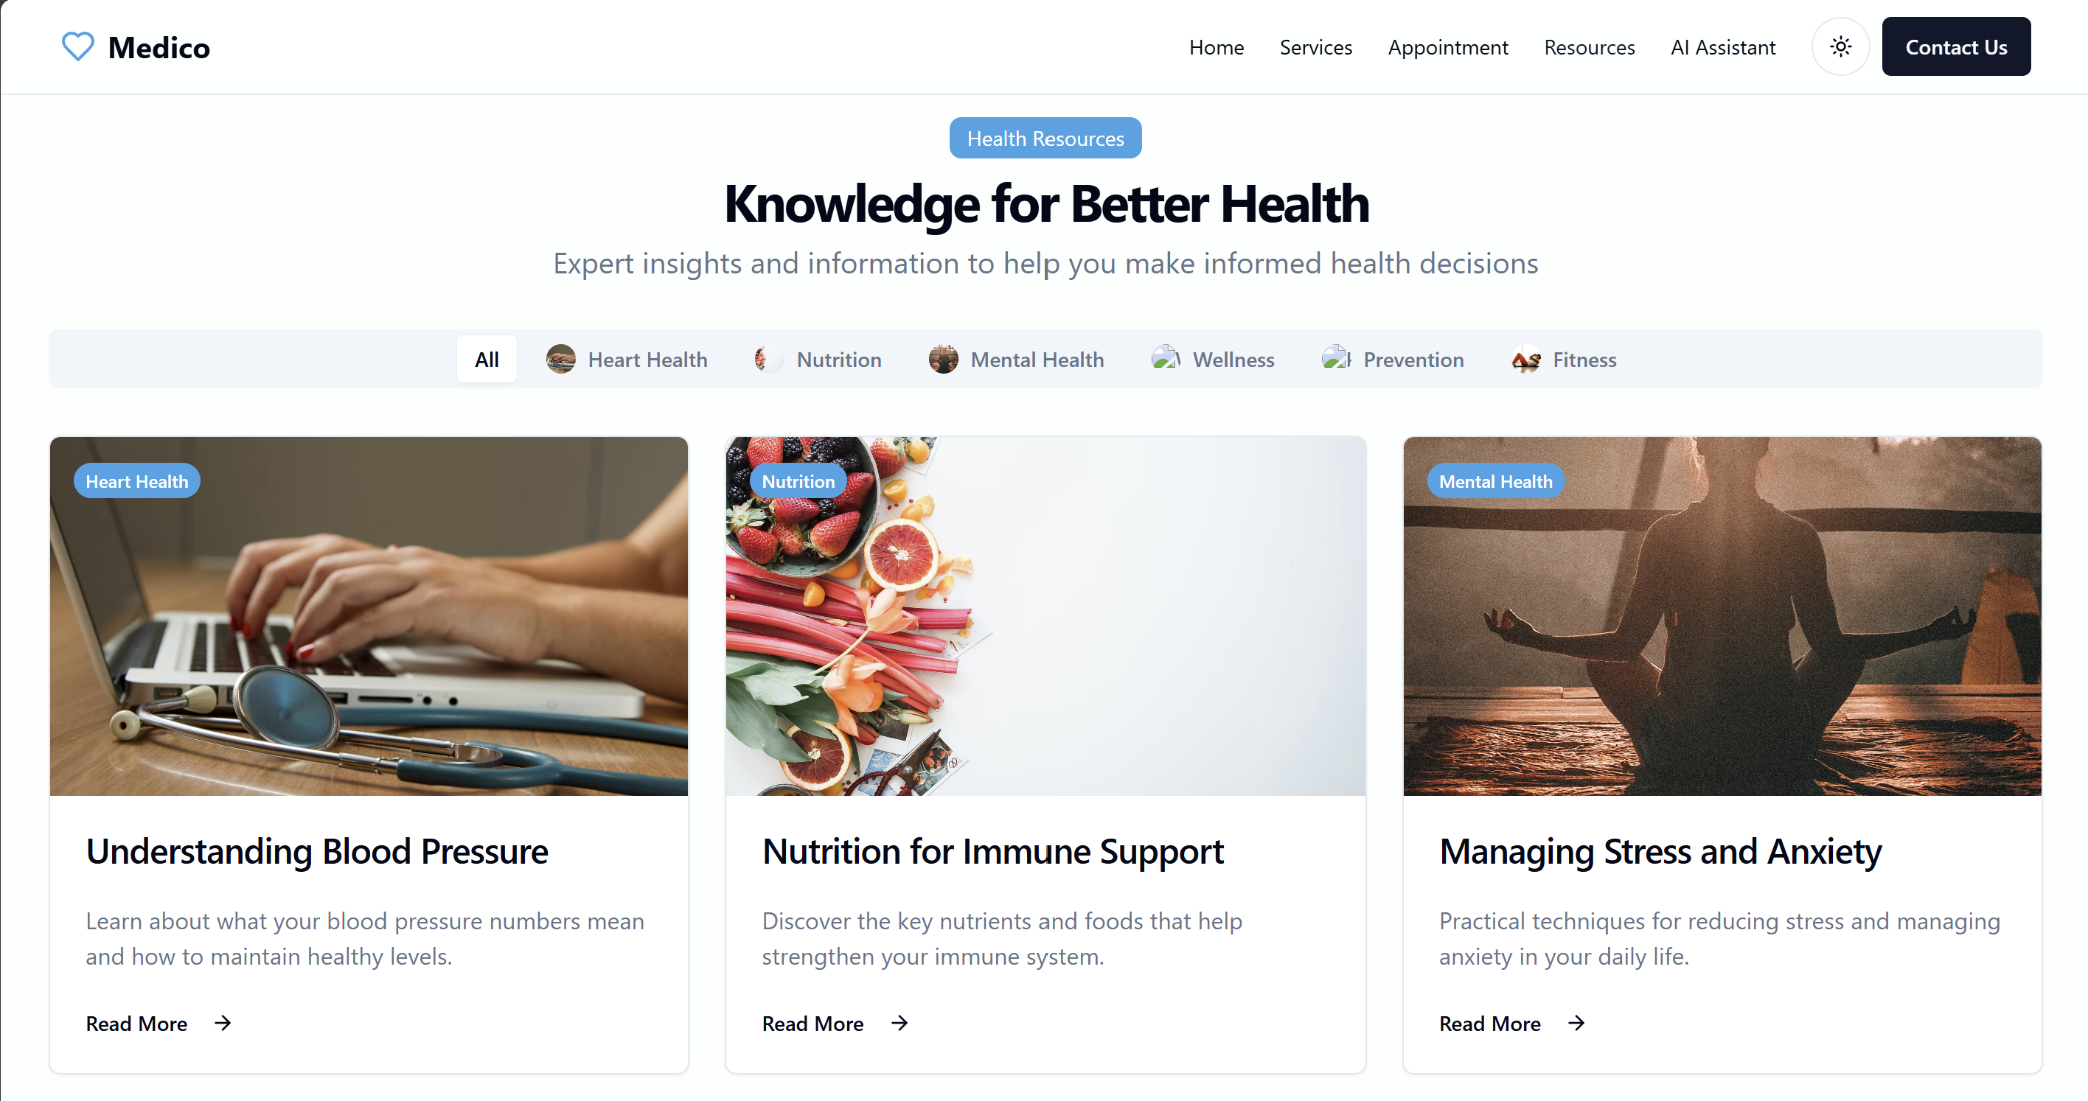

Slide 16
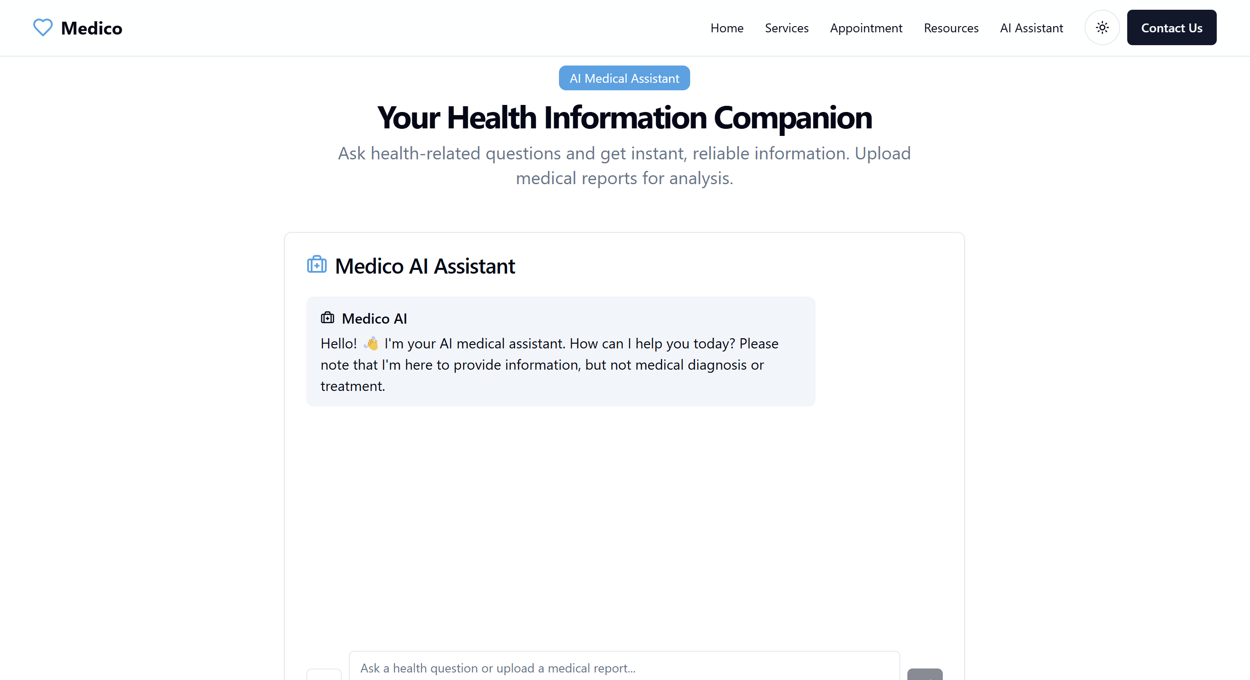

Slide 17
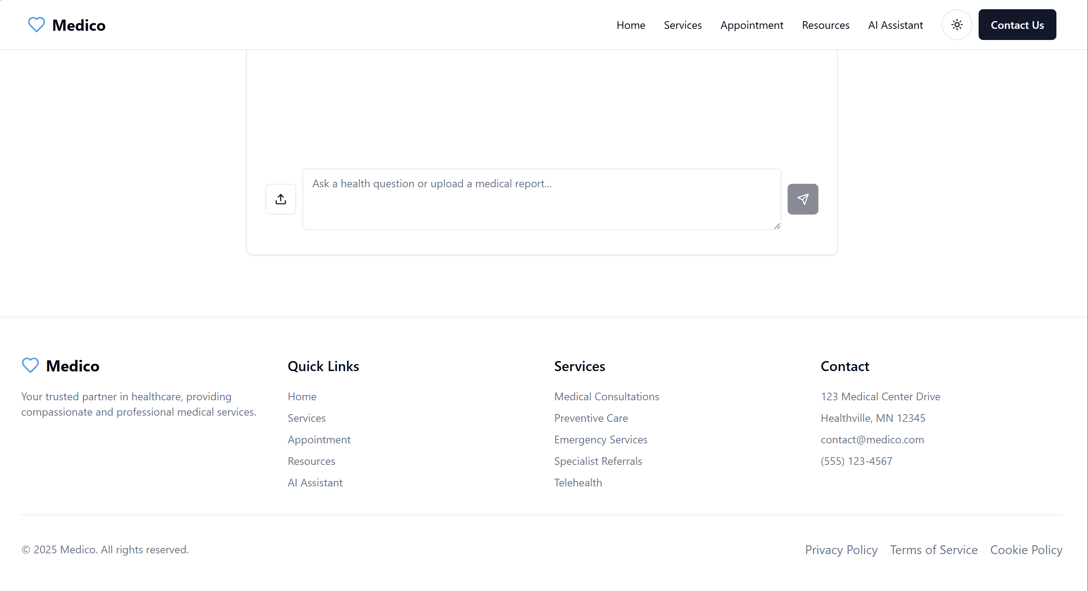

Slide 18









Project Timeline
Week 1-2: Research & Requirement Gathering.
6. Week 13-18: Deployment & Final Presentation.
Week 3-4: UI/UX Designing
4. Week 8-10: Frontend Development & Integration.
Project timeline
5 .Week 11-12: Testing & Debugging.
3 .Week 5-7: Database Setup & Backend Development.

Slide 19
Expected Results & Impact
Expected Deliverables:
Fully functional Doctor & Patient Portal
Working appointment booking system
Integrated digital prescription and medical record module
Secure cloud database for storing health data
Impact:
Improves access to healthcare services, especially in semi-urban and rural areas
Reduces manual workload for clinics and hospitals through automation
Enhances patient experience with streamlined consultations and record access
Lays the groundwork for future telemedicine and health monitoring features

Slide 20
Future Scope
AI-Powered Health Insights Suggest diagnoses, treatment plans, or health tips based on patient data and history
Telemedicine Integration Enable real-time video consultations and remote monitoring
E-Prescription & Pharmacy Linkage Directly send prescriptions to partnered pharmacies for faster service
Health Analytics Dashboard Provide doctors and admins with trends and insights for better decision-making
Mobile App for Patients & Doctors Allow appointment booking, health tracking, and report access on-the-go

Slide 21
References
WHO. (2023). Digital Health Guidelines. World Health Organization. Retrieved from: https://www.who.int/publications
Pressman, R. S., & Maxim, B. R. (2020). Software Engineering: A Practitioner’s Approach. McGraw-Hill.
Rajaraman, V. (2013). Fundamentals of Database Systems. PHI Learning.
Ministry of Health & Family Welfare (India). (2022). Telemedicine Practice Guidelines. Retrieved from: https://www.mohfw.gov.in
Mayo Clinic. (2023). Best Practices in EHR Systems & Patient Management. Retrieved from: https://www.mayoclinic.org
Health Level Seven International (HL7). (2023). FHIR Specification. Retrieved from: https://www.hl7.org/fhir/

Slide 22
THANK YOU

